Slide 1
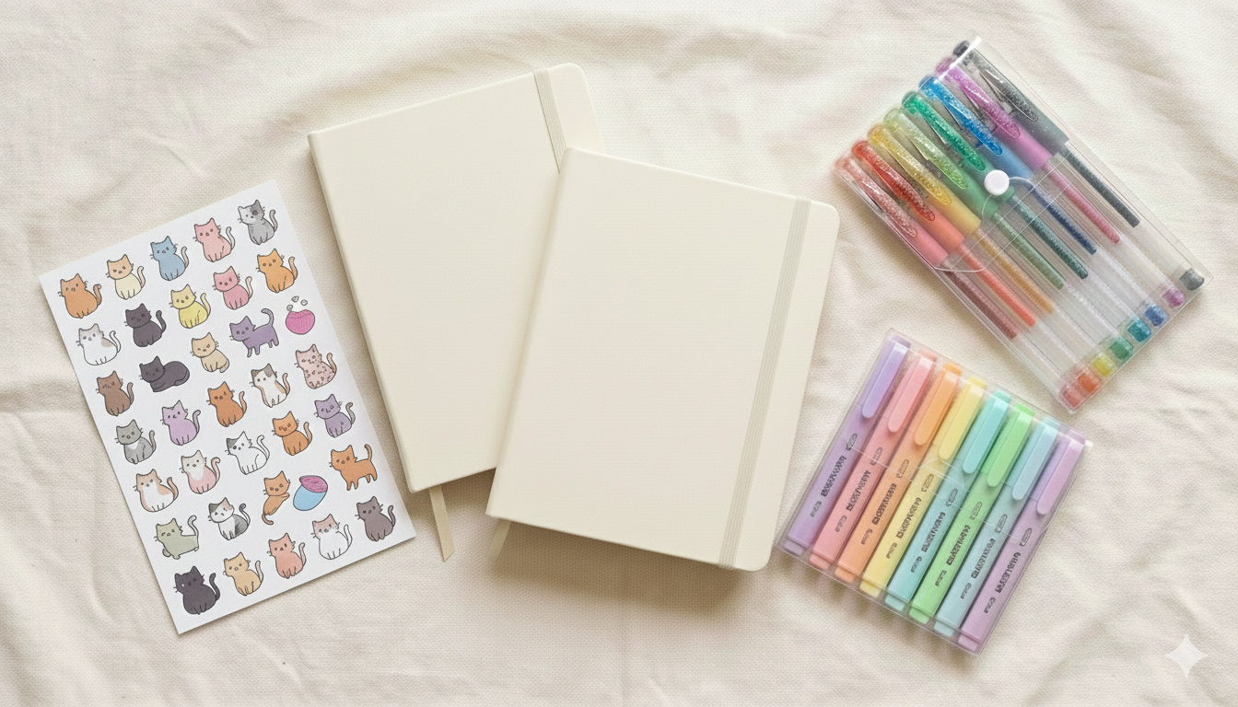

AICT Project Overview
Project Members:
Alishba Razzaq 2510301
Kashmala Rizwan 2510279
Fahad Shahzad 2510322
Haseeb Tariq 2510309

Slide 2

Introduction & Project Overview:
Information and Communication Technology (ICT) has transformed traditional businesses into digital platforms
E-commerce systems allow users to browse and manage products efficiently
This project simulates a small online stationery shop for everyday school and office items
The website displays stationery products dynamically
It is a fully client-side system that runs in a web browser without any backend server.

Slide 3

Project Objectives:
To design a clean, attractive, and user-friendly stationery e-commerce website
To implement Create, Read, Update, and Delete (CRUD) operations using JavaScript
To enable dynamic content updates without page reloads
To store and manage product data using Browser Local Storage
To apply ICT concepts practically and strengthen front-end web development skills.

Slide 4

Problem Statement & Scope
Problem Statement:
Many small stationery shops lack an online presence
Professional e-commerce solutions are expensive
Manual product management is inefficient and time-consuming
Scope of the Project:
Display stationery products online and manage them efficiently
Implement CRUD operations for product management
Provide a low-cost, easy-to-maintain solution using basic web technologies
Excludes payment gateway and user authentication

Slide 5
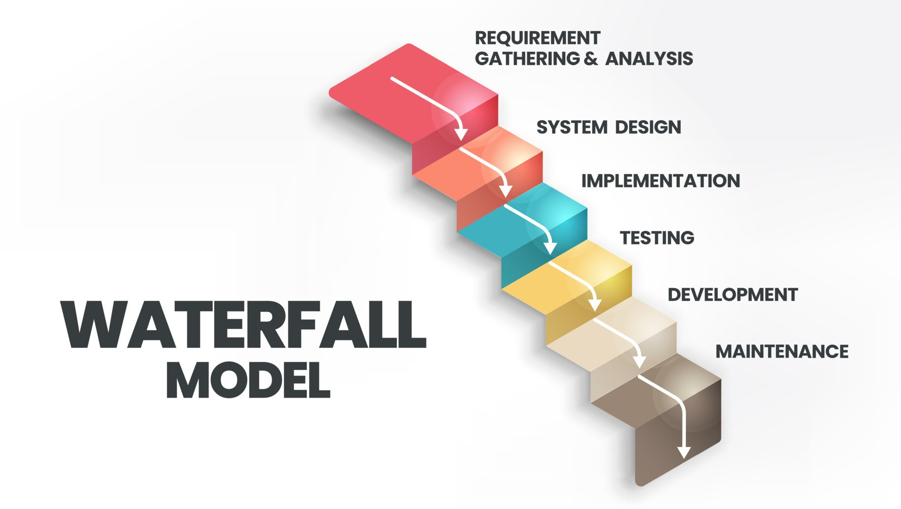
SDLC Methodology
Requirement Analysis
System Design
Implementation
Testing
Development
Maintenance

Slide 6
SDLC – Phase Explanation
Requirement Analysis: Identify product management needs
System Design: Plan layout and navigation
Implementation: Develop using HTML, CSS, JavaScript
Testing: Verify CRUD operations
Deployment: Run website in browser

Slide 7



Tools & Technologies Used:
HTML: Page structure
CSS: Styling and layout
JavaScript: CRUD operations
Local Storage: Data persistence
VS Code: Code editor
Web Browser: Execution

Slide 8
System Design & Navigation
The website uses a client-side architecture, with all data handled in the browser
No backend server or database is required
Designed for easy navigation and user-friendly experience
Admin-friendly controls allow product management
Home → Stationery Products → Add / Update / Delete Product

Slide 9
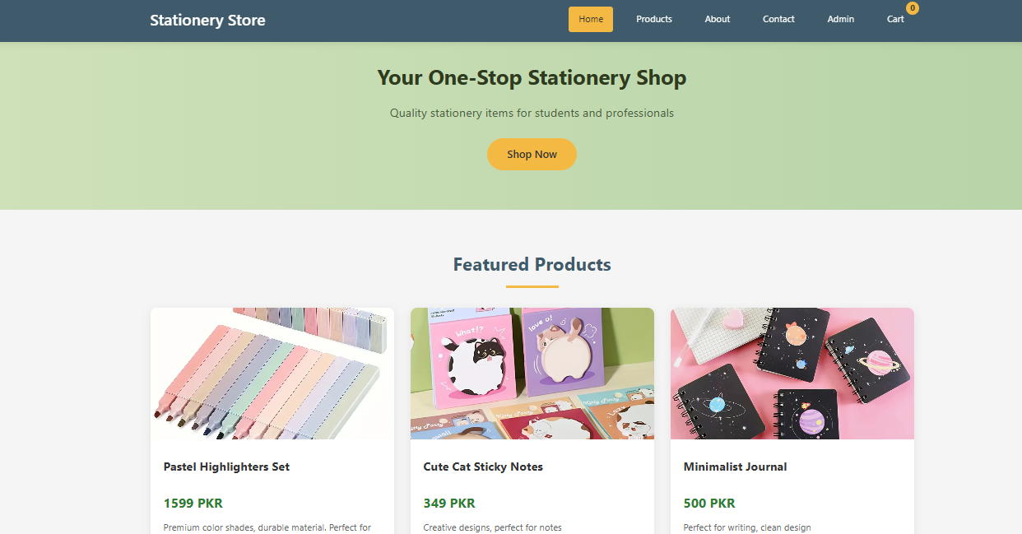
Implementation – Home Page:
Displays website name and navigation bar
Introduces the stationery shop
First interaction point for users

Slide 10
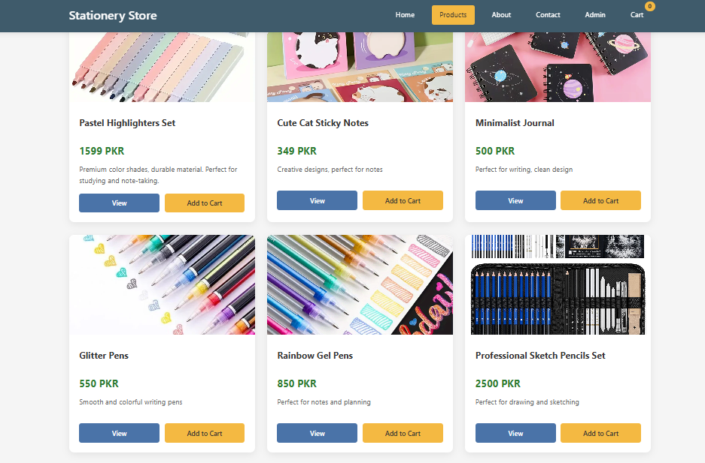
Product Page (READ)
Displays a list of stationery products
Shows product images, prices, and brief descriptions
Allows users to view detailed product information
Users can select product quantity
Action buttons such as Add to Cart are provided for purchasing.

Slide 11
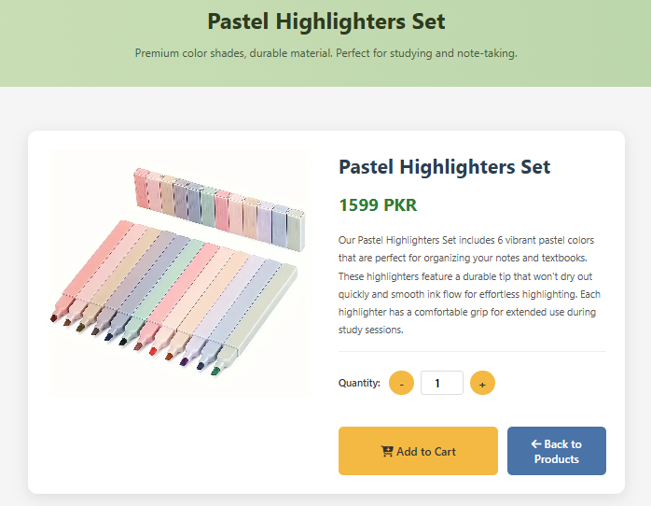
Product Details
Displays complete information of the selected product.
Shows product image, name, price, and description.
Allows users to view details before purchasing.

Slide 12
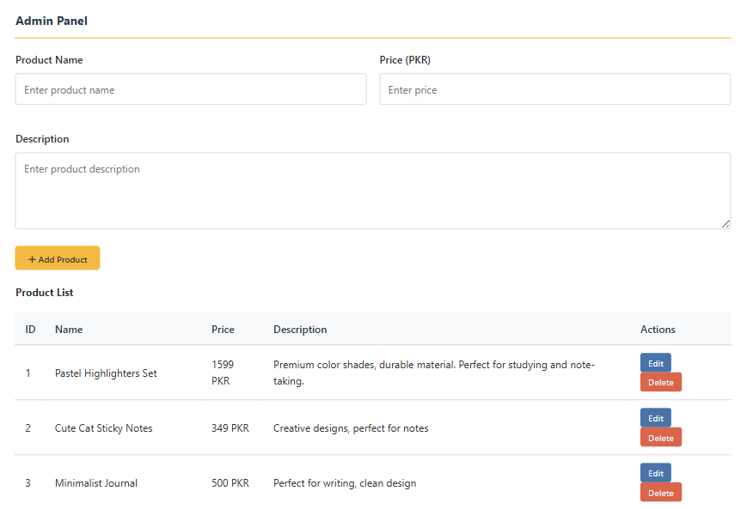
Add Product Page (CREATE)
Allows the admin to add new stationery products.
Product details such as name, price, and description are entered through this form.
Newly added items are saved and displayed dynamically.

Slide 13
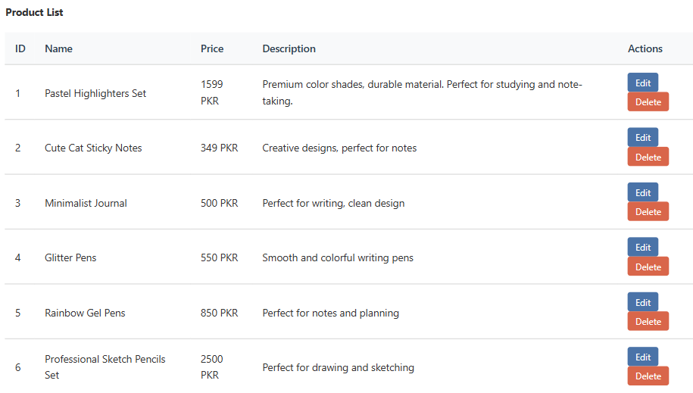
Update Page
Allows the admin to edit existing product details
Product information such as name, price, or description can be modified
Updated changes are saved and reflected immediately

Slide 14
Delete Page
Enables the admin to remove unwanted products
A confirmation is shown before deletion
Deleted items are removed from the product list dynamically

Slide 15
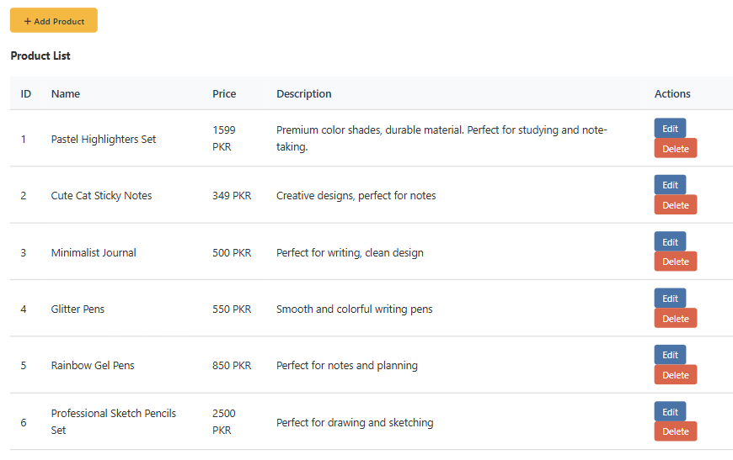
CRUD Operations Summary
Create: Add new stationery items
Read: View all products
Update: Edit product information
Delete: Remove products
All operations implemented using JavaScript

Slide 16
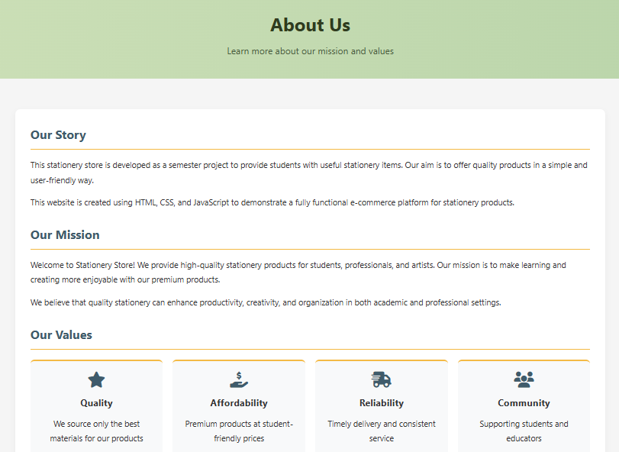
About Us
Provides information about the stationery store and its purpose
Explains the mission and services offered
Helps users understand the website and builds customer trust

Slide 17
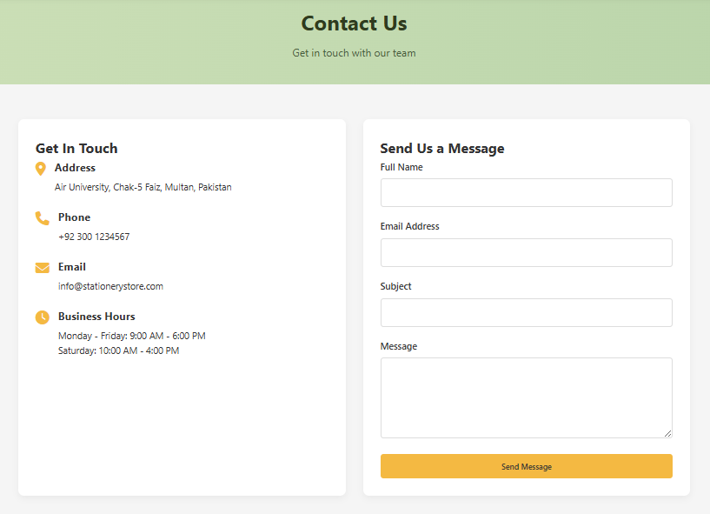
Contact Us
Integrated inquiry form for seamless customer communication.
User-friendly fields for name, email, and message submissions.
Dedicated space for handling customer support and gathering feedback.

Slide 18
Conclusion
The Stationery E-Commerce Website was successfully developed using HTML, CSS, and JavaScript.
It allows the admin to add, view, update, and delete products dynamically using Local Storage.
The project demonstrates practical application of ICT concepts and front-end development skills.
Overall, it provides a simple, user-friendly solution suitable for small-scale online stationery shops.

Slide 19
References
W3Schools
MDN Web Docs
JavaScript Documentation
Course Notes

Slide 20
THANK YOU!

